Slide 2
Dimensioning
A drawing from which a component is to be manufactured must communicate all of the required information by:
• Describing the form or shape of the component,
usually by using orthographic and sometimes pictorial views...
• Giving actual dimensions of all features of the geometry
• Giving information about any special manufacturing processes and materials required.
The design engineer should have a good understanding of projection methods,
dimensioning methods and the manufacturing methods to be used.

Slide 3
Drawing standards
ANSI – American National Standards Institute
ANSI Y14.1 1980 (R1987) – Drawing sheet size and format
ANSI Y 14.2M-1979 (R1987) – Line conventions and lettering
ANSI Y14.5M-1982(R1988) – Dimensioning and tolerances
ANSI Y 14.3-1975(R1987) – Multi view and sectional view drawings
ISO – International Standards Organization
JIS – Japanese Standards
BIS – Bureau of Indian Standards

Slide 4
Introduction - Dimensioning
Drawings are dimensioned using an accepted set of standards such as placing the dimension text
such that it is read from the bottom of the sheet.
Indicating on a drawing,
the size of the object and other details
essential for its construction and function,
using lines, numerals, symbols, notes, etc.
Dimensions indicated on a drawing should be those
that are essential for the production, inspection and
functioning of the object.

Slide 5
Dimensioning
BIS (SP 46: 2003) defines dimension as
a numerical value expressed in
appropriate units of measurement and
indicated graphically on technical drawings with lines, symbols and notes.
The important aspects of dimensioning are as follows:
Units of Measurement
The most convenient unit for length is millimeter.
Angles are shown in degrees.
Symbols are incorporated to indicate specific geometry wherever necessary.

Slide 6
Dimensioning
Individual identification of linear units is not required if
all dimensions on a drawing are in the same unit (mm).
But,
The drawing should contain a note:
ALL DIMENSIONS ARE IN mm

Slide 7
Elements of Dimensioning
Dimensioning is often done by
a set of elements, which includes
• Extension lines
• Dimension lines
• Leader lines
• Arrowheads
• Dimensions
Note, Symbols

Slide 8
Elements of Dimensioning
Dimensioning of an object is accomplished by dimensioning each element to indicate
its size (size dimensions) and
relative location (location dimensions)
from a center line, base line or finished surface.

Slide 9
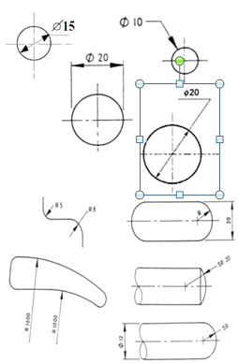
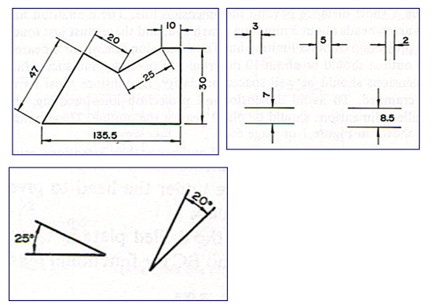
Various representation of Dimensioning

Slide 10

Aligned method Unidirectional method
No mixed system- follow either unidirectional or aligned

Slide 11
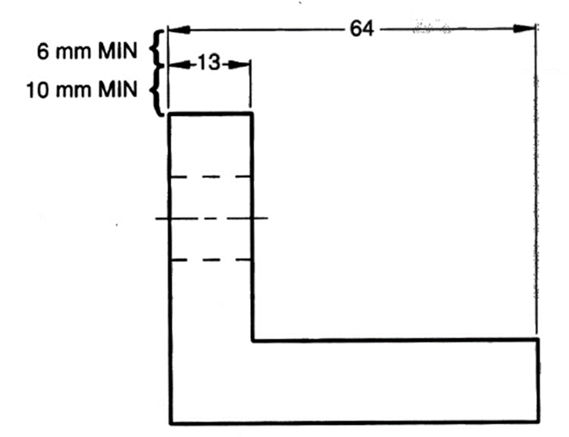
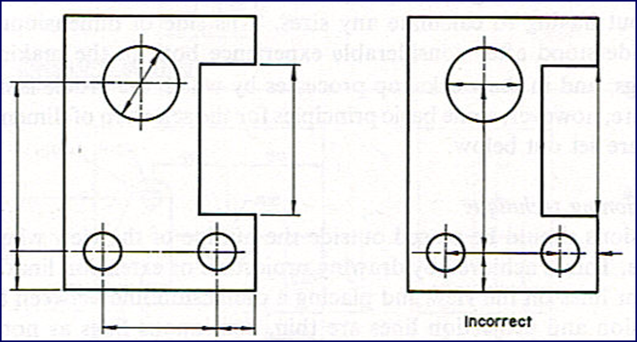
Rules
Dimension lines should be drawn at least 10 mm away from the outlines
As far as possible, all the dimensions should be placed outside the views. Inside dimensions are preferred only if they are clearer and more easily readable
Smaller dimensions should be placed nearer the view and the larger further away so that extension lines do not cross dimension lines

Slide 12
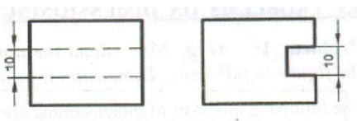
Each dimension should be given only once.
No dimension should be redundant
Dimensions should be placed outside the views
The unit should not be written after each dimension
Dimensions shall be given to visible lines and not to hidden lines

Slide 13
Do not repeat the same dimension in different views

Slide 14
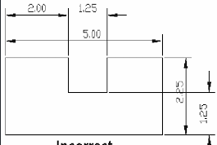
Identify the mistakes
?

